Slide 1
Network
To ensure the strongest connectivity please use the dedicated MLADS network.
SSID: MLADS 2016
Password: MLADS2016!

Slide 2
Data Science for Absolutely Everyone
Brandon Rohrer
Senior Data Scientist
Microsoft

Slide 3
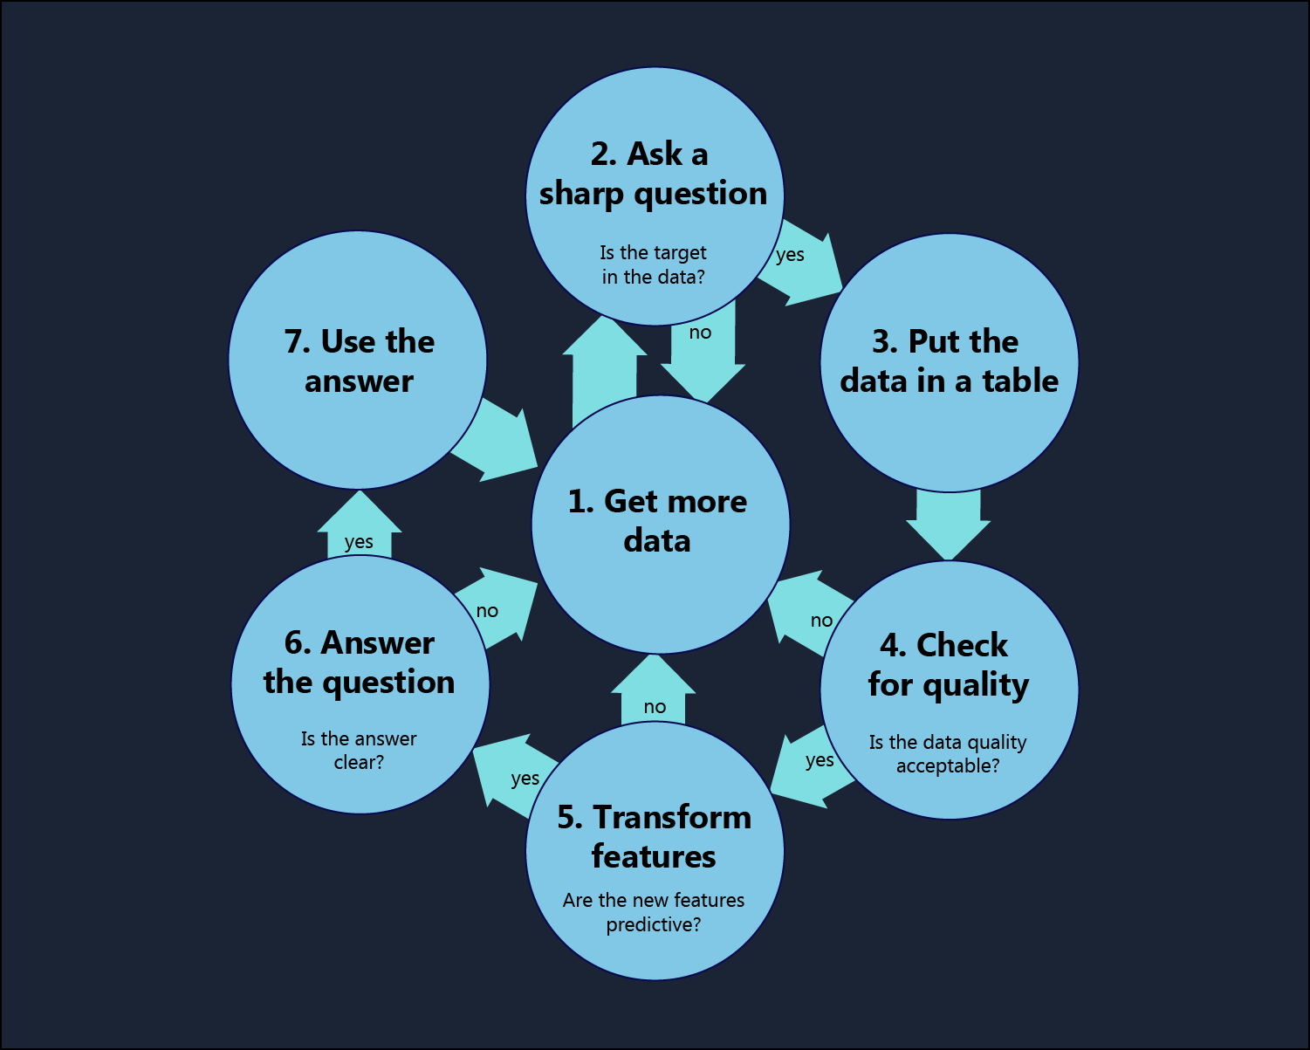
Questions or comments? brohrer@microsoft.com

Slide 5
Numbers and Names
(Numerical and Categorical)
Numbers
Amount : 38.3 degrees
Count : 39 pizzas
Money : $1,387
Pixel brightness : 232/255
Sound intensity : .64
Names
Type : Shih Tzu
Variety : Caramel latte
ID : Air Force One
Model number : R2-D2
Category : Chocolate
Text : “Best. Show. Ever. <3”
Questions or comments? brohrer@microsoft.com

Slide 6
Names that look like numbers
Phone number : 847-5609
Zip code : 90210
ID number : 007
Serial number : 100000184573
Credit card number : 5738-7539-9898-0023
Social security number : 627-42-0932
Questions or comments? brohrer@microsoft.com

Slide 7
Numbers that look like names and names that can be turned into numbers
Place : first, second, third
Size : small, medium, large
Side : left, middle, right
Time zone : Pacific, Mountain, Central, Eastern
Train stops : Kendall, Central, Harvard, Porter
Questions or comments? brohrer@microsoft.com

Slide 8
Data Engineering
Azure Event Hub
Azure Stream Analytics
Azure Data Factory
Hadoop and Spark on Azure HDInsight
Azure Search
Azure DocumentDB
Azure Data Lake
Azure Data Catalog
Measure
Collect
Store
Search
Move
Transform
Questions or comments? brohrer@microsoft.com

Slide 9
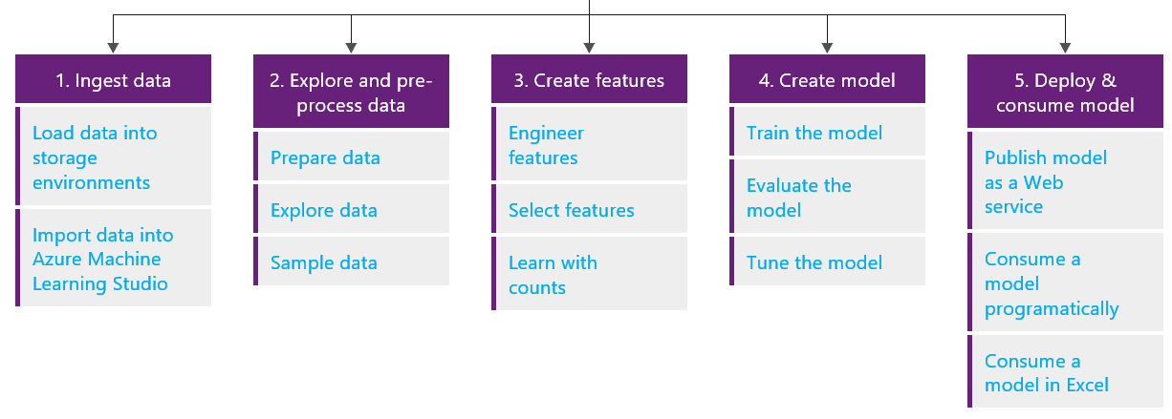
Microsoft Data Science Process
Questions or comments? brohrer@microsoft.com

Slide 11
Vague questions vs. Sharp questions
Must be answered with a name or a number.
How many times will the feature I built get used by a new user?
Which route through downtown will get me to work the fastest?
Doesn’t have to be answered with a name or a number
What can my data tell me about my business?
What should I do?
How can I increase my profits?
Questions or comments? brohrer@microsoft.com
Notes:
Data is numbers and names
Ask a question that can be answered with a number or a name

Slide 12
Target
What will my stock price be next week?
Date | Americas sales | Europe and Africa sales | Asia sales
Competitor | Product | Market share
Product | First month users | First quarter users | First year users
Date | Dow Jones | Nikkei
Questions or comments?
brohrer@microsoft.com

Slide 13
Target
Date | My stock price
What will my stock price be next week?
Date | Americas sales | Europe and Africa sales | Asia sales
Competitor | Product | Market share
Product | First month users | First quarter users | First year users
Date | Dow Jones | Nikkei
Questions or comments?
brohrer@microsoft.com

Slide 15
One target per row
Questions or comments?
brohrer@microsoft.com
Stock price | Date | Day of week | Dow Jones | Last month sales | Last quarter sales | Market share | New users last month | New users last quarter | Days since press release | Days since product release | Total users
57.3 | 5/21 | Tue | 17,245 | 68.8M | 211.2M | 23.1% | 63,522 | 195,322 | 3 | 96 | 2.49M
58.8 | 5/22 | Wed | 17,289 | 68.8M | 211.2M | 23.1% | 63,522 | 195,322 | 4 | 97 | 2.49M
56.9 | 5/23 | Thu | 17,115 | 68.8M | 211.2M | 23.1% | 63,522 | 195,322 | 5 | 98 | 2.49M
57.4 | 5/24 | Fri | 17,278 | 68.8M | 211.2M | 23.1% | 63,522 | 195,322 | 6 | 99 | 2.49M

Slide 16
One target per row
User name | Date joined
little_lil | Jan 27, 2014
popoverGuy | Jan 27, 2014
Red_Red | Jan 28, 2014
David_G_53 | Jan 30, 2014
randll | Jan 30, 2014
… | …
Aggregate
Questions or comments?
brohrer@microsoft.com
Stock price | Date | Day of week | Dow Jones | Last month sales | Last quarter sales | Market share | New users last month | New users last quarter | Days since press release | Days since product release | Total users
57.3 | 5/21 | Tue | 17,245 | 68.8M | 211.2M | 23.1% | 63,522 | 195,322 | 3 | 96 | 2.49M
58.8 | 5/22 | Wed | 17,289 | 68.8M | 211.2M | 23.1% | 63,522 | 195,322 | 4 | 97 | 2.49M
56.9 | 5/23 | Thu | 17,115 | 68.8M | 211.2M | 23.1% | 63,522 | 195,322 | 5 | 98 | 2.49M
57.4 | 5/24 | Fri | 17,278 | 68.8M | 211.2M | 23.1% | 63,522 | 195,322 | 6 | 99 | 2.49M

Slide 17
One target per row
Quarter | Total sales
2015Q4 | 119.2M
2016Q1 | 221.0M
2016Q2 | 215.9M
2016Q3 | 189.3M
2016Q4 | 211.2M
… | …
Month | Total sales
2016/01 | 43.0M
2016/02 | 60.1M
2016/03 | 55.5M
2016/04 | 41.7M
2016/05 | 68.8M
… | …
Aggregate
Distribute
Questions or comments?
brohrer@microsoft.com
Stock price | Date | Day of week | Dow Jones | Last month sales | Last quarter sales | Market share | New users last month | New users last quarter | Days since press release | Days since product release | Total users
57.3 | 5/21 | Tue | 17,245 | 68.8M | 211.2M | 23.1% | 63,522 | 195,322 | 3 | 96 | 2.493M
58.8 | 5/22 | Wed | 17,289 | 68.8M | 211.2M | 23.1% | 63,522 | 195,322 | 4 | 97 | 2.494M
56.9 | 5/23 | Thu | 17,115 | 68.8M | 211.2M | 23.1% | 63,522 | 195,322 | 5 | 98 | 2.494M
57.4 | 5/24 | Fri | 17,278 | 68.8M | 211.2M | 23.1% | 63,522 | 195,322 | 6 | 99 | 2.495M

Slide 18
One target per row
Press release date | Subject
2016/03/24 | Mega amazing whizbang
2016/05/03 | Super widget upgrade
2016/05/18 | New gizmos on the flimflam
… | …
Aggregate
Distribute
Compute
Questions or comments?
brohrer@microsoft.com
Stock price | Date | Day of week | Dow Jones | Last month sales | Last quarter sales | Market share | New users last month | New users last quarter | Days since press release | Days since product release | Total users
57.3 | 5/21 | Tue | 17,245 | 68.8M | 211.2M | 23.1% | 63,522 | 195,322 | 3 | 96 | 2.49M
58.8 | 5/22 | Wed | 17,289 | 68.8M | 211.2M | 23.1% | 63,522 | 195,322 | 4 | 97 | 2.49M
56.9 | 5/23 | Thu | 17,115 | 68.8M | 211.2M | 23.1% | 63,522 | 195,322 | 5 | 98 | 2.49M
57.4 | 5/24 | Fri | 17,278 | 68.8M | 211.2M | 23.1% | 63,522 | 195,322 | 6 | 99 | 2.49M

Slide 19
One target per row
Measure
Aggregate
Distribute
Compute
Questions or comments?
brohrer@microsoft.com
Stock price | Date | Day of week | Dow Jones | Last month sales | Last quarter sales | Market share | New users last month | New users last quarter | Days since press release | Days since product release | Total users
57.3 | 5/21 | Tue | 17,245 | 68.8M | 211.2M | 23.1% | 63,522 | 195,322 | 3 | 96 | 2.49M
58.8 | 5/22 | Wed | 17,289 | 68.8M | 211.2M | 23.1% | 63,522 | 195,322 | 4 | 97 | 2.49M
56.9 | 5/23 | Thu | 17,115 | 68.8M | 211.2M | 23.1% | 63,522 | 195,322 | 5 | 98 | 2.49M
57.4 | 5/24 | Fri | 17,278 | 68.8M | 211.2M | 23.1% | 63,522 | 195,322 | 6 | 99 | 2.49M

Slide 20
One target per row
Measure
Estimate
Aggregate
Distribute
Compute
Questions or comments?
brohrer@microsoft.com
Stock price | Date | Day of week | Dow Jones | Last month sales | Last quarter sales | Market share | New users last month | New users last quarter | Days since press release | Days since product release | Total users
57.3 | 5/21 | Tue | 17,245 | 68.8M | 211.2M | 23.1% | 63,522 | 195,322 | 3 | 96 | 2.49M
58.8 | 5/22 | Wed | 17,289 | 68.8M | 211.2M | 23.1% | 63,522 | 195,322 | 4 | 97 | 2.49M
56.9 | 5/23 | Thu | 17,115 | 68.8M | 211.2M | 23.1% | 63,522 | 195,322 | 5 | 98 | 2.49M
57.4 | 5/24 | Fri | 17,278 | 68.8M | 211.2M | 23.1% | 63,522 | 195,322 | 6 | 99 | 2.49M

Slide 21
One target per row
Measure
Estimate
Leave blanks
Aggregate
Distribute
Compute
Questions or comments?
brohrer@microsoft.com
Stock price | Date | Day of week | Dow Jones | Last month sales | Last quarter sales | Market share | New users last month | New users last quarter | Days since press release | Days since product release | Total users
57.3 | 5/21 | Tue | 17,245 | 68.8M | 211.2M | 23.1% | 63,522 | 195,322 | 3 | 96 | 2.49M
58.8 | 5/22 | Wed | 17,289 | 68.8M | 211.2M | 23.1% | 63,522 | 195,322 | 4 | 97 | 2.49M
56.9 | 5/23 | Thu | 17,115 | 68.8M | 211.2M | 23.1% | 63,522 | 195,322 | 5 | 98 | 2.49M
57.4 | 5/24 | Fri | 17,278 | 68.8M | 211.2M | 23.1% | 63,522 | 195,322 | 6 | 99 | 2.49M

Slide 23
Ways to create new features
ID | First name | Last name | Birth year | Height | Birthplace | Identity is secret | Can fly | Alignment | Wears cape
7435 | Bruce | Wayne | 1969* | 6’ 2” | Gotham | Y | 3 | anti-villain | black
0958 | Ororo | Munroe | --1979-- | 5’ 11” | Manhattan |  | 9 | good | long
9471 | Diana | Trevor | 1618 | 5’ 8” | Paradise Island | Y | Jet | truth | rarely
9483 | Janet | Van Dyne | 19.42 | 5’ 4” | Cresskill |  | tiny | Good | Not really
0696 | Peter | Parker | 1111983 | 5’ 10” | Queens | Y | Fall | right | never
5531 | Harleen | Quinzell | 1981 | 5’ 2” | Gotham | Y | - | evil | no
4734 | Erik | Lehnsherr | 1-9-3-2 | 6’ 0” | Hamburg |  | Lev. | mutants | Absolutely
7757 | Natasha | Romanova | 1983 | 5’ 7” | St. Petersburg |  | jet | depends | No way
0323 | Jean | Grey | “1977” | 5’ 6” | Annandale |  | No | good | Mostly not
3980 | Clark | Kent | “1954” | 6’ 4” | Krypton | Y | 12 | Truth | always
3057 | Victor | Von Doom | “1943” | 6’ 2” | Latveria |  | 1 | Bad | yes
0573 | Stephen | Strange | 1968 | 6’ 2” | Philidelphia |  | not | light | Y
7452 | Thor | Odinson | 2287 BC | 6’ 6” | Norway |  | 10 | Good | Of course
1437 | Selina | Kyle | 1998 | 5’ 7” | Gotham | Y | NA | Neutral | It clashes
1883 | Raven | Darkholme | ..1911.. | 5’ 10” | unknown | Y | no | mostly bad | Not really
5830 | Kara | Zor-el | 1961 | 5’ 7” | Krypton | Y | fast | G | Yes

Slide 24
Ways to create new features
ID | First name | Last name | Birth year | Height | Birthplace | Identity is secret | Can fly | Alignment | Wears cape
7435 | Bruce | Wayne | 1969* | 6’ 2” | Gotham | Y | 3 | anti-villain | black
0958 | Ororo | Munroe | --1979-- | 5’ 11” | Manhattan |  | 9 | good | long
9471 | Diana | Trevor | 1618 | 5’ 8” | Paradise Island | Y | Jet | truth | rarely
9483 | Janet | Van Dyne | 19.42 | 5’ 4” | Cresskill |  | tiny | Good | Not really
0696 | Peter | Parker | 1111983 | 5’ 10” | Queens | Y | Fall | right | never
5531 | Harleen | Quinzell | 1981 | 5’ 2” | Gotham | Y | - | evil | no
4734 | Erik | Lehnsherr | 1-9-3-2 | 6’ 0” | Hamburg |  | Lev. | mutants | Absolutely
7757 | Natasha | Romanova | 1983 | 5’ 7” | St. Petersburg |  | jet | depends | No way
0323 | Jean | Grey | “1977” | 5’ 6” | Annandale |  | No | good | Mostly not
3980 | Clark | Kent | “1954” | 6’ 4” | Krypton | Y | 12 | Truth | always
3057 | Victor | Von Doom | “1943” | 6’ 2” | Latveria |  | 1 | Bad | yes
0573 | Stephen | Strange | 1968 | 6’ 2” | Philidelphia |  | not | light | Y
7452 | Thor | Odinson | 2287 BC | 6’ 6” | Norway |  | 10 | Good | Of course
1437 | Selina | Kyle | 1998 | 5’ 7” | Gotham | Y | NA | Neutral | It clashes
1883 | Raven | Darkholme | ..1911.. | 5’ 10” | unknown | Y | no | mostly bad | Not really
5830 | Kara | Zor-el | 1961 | 5’ 7” | Krypton | Y | fast | G | Yes

Slide 25
Ways to create new features
ID | First name | Last name | Birth year | Height | Birthplace | Identity is secret | Can fly | Alignment | Wears cape
7435 | Bruce | Wayne | 1969 | 6’ 2” | Gotham | Y | 3 | anti-villain | black
0958 | Ororo | Munroe | 1979 | 5’ 11” | Manhattan |  | 9 | good | long
9471 | Diana | Trevor | 1618 | 5’ 8” | Paradise Island | Y | Jet | truth | rarely
9483 | Janet | Van Dyne | 1942 | 5’ 4” | Cresskill |  | tiny | Good | Not really
0696 | Peter | Parker | 1983 | 5’ 10” | Queens | Y | Fall | right | never
5531 | Harleen | Quinzell | 1981 | 5’ 2” | Gotham | Y | - | evil | no
4734 | Erik | Lehnsherr | 1932 | 6’ 0” | Hamburg |  | Lev. | mutants | Absolutely
7757 | Natasha | Romanova | 1983 | 5’ 7” | St. Petersburg |  | jet | depends | No way
0323 | Jean | Grey | 1977 | 5’ 6” | Annandale |  | No | good | Mostly not
3980 | Clark | Kent | 1954 | 6’ 4” | Krypton | Y | 12 | Truth | always
3057 | Victor | Von Doom | 1943 | 6’ 2” | Latveria |  | 1 | Bad | yes
0573 | Stephen | Strange | 1968 | 6’ 2” | Philidelphia |  | not | light | Y
7452 | Thor | Odinson | -2287 | 6’ 6” | Norway |  | 10 | Good | Of course
1437 | Selina | Kyle | 1998 | 5’ 7” | Gotham | Y | NA | Neutral | It clashes
1883 | Raven | Darkholme | 1911 | 5’ 10” | unknown | Y | no | mostly bad | Not really
5830 | Kara | Zor-el | 1961 | 5’ 7” | Krypton | Y | fast | G | Yes

Slide 26
Ways to create new features
ID | First name | Last name | Birth year | Height | Birthplace | Identity is secret | Can fly | Alignment | Wears cape
7435 | Bruce | Wayne | 1969 | 6’ 2” | Gotham | Y | 3 | anti-villain | black
0958 | Ororo | Munroe | 1979 | 5’ 11” | Manhattan |  | 9 | good | long
9471 | Diana | Trevor | 1618 | 5’ 8” | Paradise Island | Y | Jet | truth | rarely
9483 | Janet | Van Dyne | 1942 | 5’ 4” | Cresskill |  | tiny | Good | Not really
0696 | Peter | Parker | 1983 | 5’ 10” | Queens | Y | Fall | right | never
5531 | Harleen | Quinzell | 1981 | 5’ 2” | Gotham | Y | - | evil | no
4734 | Erik | Lehnsherr | 1932 | 6’ 0” | Hamburg |  | Lev. | mutants | Absolutely
7757 | Natasha | Romanova | 1983 | 5’ 7” | St. Petersburg |  | jet | depends | No way
0323 | Jean | Grey | 1977 | 5’ 6” | Annandale |  | No | good | Mostly not
3980 | Clark | Kent | 1954 | 6’ 4” | Krypton | Y | 12 | Truth | always
3057 | Victor | Von Doom | 1943 | 6’ 2” | Latveria |  | 1 | Bad | yes
0573 | Stephen | Strange | 1968 | 6’ 2” | Philidelphia |  | not | light | Y
7452 | Thor | Odinson | -2287 | 6’ 6” | Norway |  | 10 | Good | Of course
1437 | Selina | Kyle | 1998 | 5’ 7” | Gotham | Y | NA | Neutral | It clashes
1883 | Raven | Darkholme | 1911 | 5’ 10” | unknown | Y | no | mostly bad | Not really
5830 | Kara | Zor-el | 1961 | 5’ 7” | Krypton | Y | fast | G | Yes

Slide 27
Ways to create new features
ID | First name | Last name | Birth year | Height | Birthplace | Identity is secret | Can fly | Alignment | Wears cape
7435 | Bruce | Wayne | 1969 | 74 | Gotham | Y | 3 | anti-villain | black
0958 | Ororo | Munroe | 1979 | 71 | Manhattan |  | 9 | good | long
9471 | Diana | Trevor | 1618 | 68 | Paradise Island | Y | Jet | truth | rarely
9483 | Janet | Van Dyne | 1942 | 64 | Cresskill |  | tiny | Good | Not really
0696 | Peter | Parker | 1983 | 70 | Queens | Y | Fall | right | never
5531 | Harleen | Quinzell | 1981 | 62 | Gotham | Y | - | evil | no
4734 | Erik | Lehnsherr | 1932 | 72 | Hamburg |  | Lev. | mutants | Absolutely
7757 | Natasha | Romanova | 1983 | 67 | St. Petersburg |  | jet | depends | No way
0323 | Jean | Grey | 1977 | 66 | Annandale |  | No | good | Mostly not
3980 | Clark | Kent | 1954 | 76 | Krypton | Y | 12 | Truth | always
3057 | Victor | Von Doom | 1943 | 74 | Latveria |  | 1 | Bad | yes
0573 | Stephen | Strange | 1968 | 74 | Philidelphia |  | not | light | Y
7452 | Thor | Odinson | -2287 | 78 | Norway |  | 10 | Good | Of course
1437 | Selina | Kyle | 1998 | 67 | Gotham | Y | NA | Neutral | It clashes
1883 | Raven | Darkholme | 1911 | 70 | unknown | Y | no | mostly bad | Not really
5830 | Kara | Zor-el | 1961 | 67 | Krypton | Y | fast | G | Yes

Slide 28
Ways to create new features
ID | First name | Last name | Birth year | Height | Birthplace | Identity is secret | Can fly | Alignment | Wears cape
7435 | Bruce | Wayne | 1969 | 74 | Gotham | Y | 3 | anti-villain | black
0958 | Ororo | Munroe | 1979 | 71 | Manhattan | NA | 9 | good | long
9471 | Diana | Trevor | 1618 | 68 | Paradise Island | Y | Jet | truth | rarely
9483 | Janet | Van Dyne | 1942 | 64 | Cresskill |  | tiny | Good | Not really
0696 | Peter | Parker | 1983 | 70 | Queens | Y | Fall | right | never
5531 | Harleen | Quinzell | 1981 | 62 | Gotham | Y | - | evil | no
4734 | Erik | Lehnsherr | 1932 | 72 | Hamburg | NA | Lev. | mutants | Absolutely
7757 | Natasha | Romanova | 1983 | 67 | St. Petersburg | NA | jet | depends | No way
0323 | Jean | Grey | 1977 | 66 | Annandale |  | No | good | Mostly not
3980 | Clark | Kent | 1954 | 76 | Krypton | Y | 12 | Truth | always
3057 | Victor | Von Doom | 1943 | 74 | Latveria | Missing | 1 | Bad | yes
0573 | Stephen | Strange | 1968 | 74 | Philidelphia |  | not | light | Y
7452 | Thor | Odinson | -2287 | 78 | Norway |  | 10 | Good | Of course
1437 | Selina | Kyle | 1998 | 67 | Gotham | Y | NA | Neutral | It clashes
1883 | Raven | Darkholme | 1911 | 70 | unknown | Y | no | mostly bad | Not really
5830 | Kara | Zor-el | 1961 | 67 | Krypton | Y | fast | G | Yes

Slide 29
Ways to create new features
ID | First name | Last name | Birth year | Height | Birthplace | Identity is secret | Can fly | Alignment | Wears cape
7435 | Bruce | Wayne | 1969 | 74 | Gotham | Y | 3 | anti-villain | black
0958 | Ororo | Munroe | 1979 | 71 | Manhattan | N | 9 | good | long
9471 | Diana | Trevor | 1618 | 68 | Paradise Island | Y | Jet | truth | rarely
9483 | Janet | Van Dyne | 1942 | 64 | Cresskill | N | tiny | Good | Not really
0696 | Peter | Parker | 1983 | 70 | Queens | Y | Fall | right | never
5531 | Harleen | Quinzell | 1981 | 62 | Gotham | Y | - | evil | no
4734 | Erik | Lehnsherr | 1932 | 72 | Hamburg | N | Lev. | mutants | Absolutely
7757 | Natasha | Romanova | 1983 | 67 | St. Petersburg | N | jet | depends | No way
0323 | Jean | Grey | 1977 | 66 | Annandale | N | No | good | Mostly not
3980 | Clark | Kent | 1954 | 76 | Krypton | Y | 12 | Truth | always
3057 | Victor | Von Doom | 1943 | 74 | Latveria | N | 1 | Bad | yes
0573 | Stephen | Strange | 1968 | 74 | Philidelphia | N | not | light | Y
7452 | Thor | Odinson | -2287 | 78 | Norway | N | 10 | Good | Of course
1437 | Selina | Kyle | 1998 | 67 | Gotham | Y | NA | Neutral | It clashes
1883 | Raven | Darkholme | 1911 | 70 | unknown | Y | no | mostly bad | Not really
5830 | Kara | Zor-el | 1961 | 67 | Krypton | Y | fast | G | Yes

Slide 30
Ways to create new features
ID | First name | Last name | Birth year | Height | Birthplace | Identity is secret | Can fly | Alignment | Wears cape
7435 | Bruce | Wayne | 1969 | 74 | Gotham | Y | 3 | anti-villain | black
0958 | Ororo | Munroe | 1979 | 71 | Manhattan | N | 9 | good | long
9471 | Diana | Trevor | 1618 | 68 | Paradise Island | Y | Jet | truth | rarely
9483 | Janet | Van Dyne | 1942 | 64 | Cresskill | N | tiny | Good | Not really
0696 | Peter | Parker | 1983 | 70 | Queens | Y | Fall | right | never
5531 | Harleen | Quinzell | 1981 | 62 | Gotham | Y | - | evil | no
4734 | Erik | Lehnsherr | 1932 | 72 | Hamburg | N | Lev. | mutants | Absolutely
7757 | Natasha | Romanova | 1983 | 67 | St. Petersburg | N | jet | depends | No way
0323 | Jean | Grey | 1977 | 66 | Annandale | N | No | good | Mostly not
3980 | Clark | Kent | 1954 | 76 | Krypton | Y | 12 | Truth | always
3057 | Victor | Von Doom | 1943 | 74 | Latveria | N | 1 | Bad | yes
0573 | Stephen | Strange | 1968 | 74 | Philidelphia | N | not | light | Y
7452 | Thor | Odinson | -2287 | 78 | Norway | N | 10 | Good | Of course
1437 | Selina | Kyle | 1998 | 67 | Gotham | Y | NA | Neutral | It clashes
1883 | Raven | Darkholme | 1911 | 70 | unknown | Y | no | mostly bad | Not really
5830 | Kara | Zor-el | 1961 | 67 | Krypton | Y | fast | G | Yes

Slide 31
Ways to create new features
ID | First name | Last name | Birth year | Height | Birthplace | Identity is secret | Can fly | Alignment | Wears cape
7435 | Bruce | Wayne | 1969 | 74 | Gotham | Y | N | anti-villain | black
0958 | Ororo | Munroe | 1979 | 71 | Manhattan | N | Y | good | long
9471 | Diana | Trevor | 1618 | 68 | Paradise Island | Y | N | truth | rarely
9483 | Janet | Van Dyne | 1942 | 64 | Cresskill | N | Y | Good | Not really
0696 | Peter | Parker | 1983 | 70 | Queens | Y | N | right | never
5531 | Harleen | Quinzell | 1981 | 62 | Gotham | Y | N | evil | no
4734 | Erik | Lehnsherr | 1932 | 72 | Hamburg | N | N | mutants | Absolutely
7757 | Natasha | Romanova | 1983 | 67 | St. Petersburg | N | N | depends | No way
0323 | Jean | Grey | 1977 | 66 | Annandale | N | N | good | Mostly not
3980 | Clark | Kent | 1954 | 76 | Krypton | Y | Y | Truth | always
3057 | Victor | Von Doom | 1943 | 74 | Latveria | N | N | Bad | yes
0573 | Stephen | Strange | 1968 | 74 | Philidelphia | N | N | light | Y
7452 | Thor | Odinson | -2287 | 78 | Norway | N | Y | Good | Of course
1437 | Selina | Kyle | 1998 | 67 | Gotham | Y | N | Neutral | It clashes
1883 | Raven | Darkholme | 1911 | 70 | unknown | Y | N | mostly bad | Not really
5830 | Kara | Zor-el | 1961 | 67 | Krypton | Y | Y | G | Yes

Slide 32
Ways to create new features
ID | First name | Last name | Birth year | Height | Birthplace | Identity is secret | Can fly | Alignment | Wears cape
7435 | Bruce | Wayne | 1969 | 74 | Gotham | Y | N | anti-villain | black
0958 | Ororo | Munroe | 1979 | 71 | Manhattan | N | Y | good | long
9471 | Diana | Trevor | 1618 | 68 | Paradise Island | Y | N | truth | rarely
9483 | Janet | Van Dyne | 1942 | 64 | Cresskill | N | Y | Good | Not really
0696 | Peter | Parker | 1983 | 70 | Queens | Y | N | right | never
5531 | Harleen | Quinzell | 1981 | 62 | Gotham | Y | N | evil | no
4734 | Erik | Lehnsherr | 1932 | 72 | Hamburg | N | N | mutants | Absolutely
7757 | Natasha | Romanova | 1983 | 67 | St. Petersburg | N | N | depends | No way
0323 | Jean | Grey | 1977 | 66 | Annandale | N | N | good | Mostly not
3980 | Clark | Kent | 1954 | 76 | Krypton | Y | Y | Truth | always
3057 | Victor | Von Doom | 1943 | 74 | Latveria | N | N | Bad | yes
0573 | Stephen | Strange | 1968 | 74 | Philidelphia | N | N | light | Y
7452 | Thor | Odinson | -2287 | 78 | Norway | N | Y | Good | Of course
1437 | Selina | Kyle | 1998 | 67 | Gotham | Y | N | Neutral | It clashes
1883 | Raven | Darkholme | 1911 | 70 | unknown | Y | N | mostly bad | Not really
5830 | Kara | Zor-el | 1961 | 67 | Krypton | Y | Y | G | Yes

Slide 33
Ways to create new features
ID | First name | Last name | Birth year | Height | Birthplace | Identity is secret | Can fly | Alignment | Wears cape
7435 | Bruce | Wayne | 1969 | 74 | Gotham | Y | N | Good | black
0958 | Ororo | Munroe | 1979 | 71 | Manhattan | N | Y | Good | long
9471 | Diana | Trevor | 1618 | 68 | Paradise Island | Y | N | Good | rarely
9483 | Janet | Van Dyne | 1942 | 64 | Cresskill | N | Y | Good | Not really
0696 | Peter | Parker | 1983 | 70 | Queens | Y | N | Good | never
5531 | Harleen | Quinzell | 1981 | 62 | Gotham | Y | N | Bad | no
4734 | Erik | Lehnsherr | 1932 | 72 | Hamburg | N | N | Bad | Absolutely
7757 | Natasha | Romanova | 1983 | 67 | St. Petersburg | N | N | Good | No way
0323 | Jean | Grey | 1977 | 66 | Annandale | N | N | Good | Mostly not
3980 | Clark | Kent | 1954 | 76 | Krypton | Y | Y | Good | always
3057 | Victor | Von Doom | 1943 | 74 | Latveria | N | N | Bad | yes
0573 | Stephen | Strange | 1968 | 74 | Philidelphia | N | N | Good | Y
7452 | Thor | Odinson | -2287 | 78 | Norway | N | Y | Good | Of course
1437 | Selina | Kyle | 1998 | 67 | Gotham | Y | N | Neutral | It clashes
1883 | Raven | Darkholme | 1911 | 70 | unknown | Y | N | Bad | Not really
5830 | Kara | Zor-el | 1961 | 67 | Krypton | Y | Y | Good | Yes

Slide 34
Ways to create new features
ID | First name | Last name | Birth year | Height | Birthplace | Identity is secret | Can fly | Alignment | Wears cape
7435 | Bruce | Wayne | 1969 | 74 | Gotham | Y | N | Good | black
0958 | Ororo | Munroe | 1979 | 71 | Manhattan | N | Y | Good | long
9471 | Diana | Trevor | 1618 | 68 | Paradise Island | Y | N | Good | rarely
9483 | Janet | Van Dyne | 1942 | 64 | Cresskill | N | Y | Good | Not really
0696 | Peter | Parker | 1983 | 70 | Queens | Y | N | Good | never
5531 | Harleen | Quinzell | 1981 | 62 | Gotham | Y | N | Bad | no
4734 | Erik | Lehnsherr | 1932 | 72 | Hamburg | N | N | Bad | Absolutely
7757 | Natasha | Romanova | 1983 | 67 | St. Petersburg | N | N | Good | No way
0323 | Jean | Grey | 1977 | 66 | Annandale | N | N | Good | Mostly not
3980 | Clark | Kent | 1954 | 76 | Krypton | Y | Y | Good | always
3057 | Victor | Von Doom | 1943 | 74 | Latveria | N | N | Bad | yes
0573 | Stephen | Strange | 1968 | 74 | Philidelphia | N | N | Good | Y
7452 | Thor | Odinson | -2287 | 78 | Norway | N | Y | Good | Of course
1437 | Selina | Kyle | 1998 | 67 | Gotham | Y | N | Neutral | It clashes
1883 | Raven | Darkholme | 1911 | 70 | unknown | Y | N | Bad | Not really
5830 | Kara | Zor-el | 1961 | 67 | Krypton | Y | Y | Good | Yes

Slide 35
Ways to create new features
ID | First name | Last name | Birth year | Height | Birthplace | Identity is secret | Can fly | Alignment | Wears cape
7435 | Bruce | Wayne | 1969 | 74 | Gotham | Y | N | Good | Y
0958 | Ororo | Munroe | 1979 | 71 | Manhattan | N | Y | Good | Y
9471 | Diana | Trevor | 1618 | 68 | Paradise Island | Y | N | Good | N
9483 | Janet | Van Dyne | 1942 | 64 | Cresskill | N | Y | Good | N
0696 | Peter | Parker | 1983 | 70 | Queens | Y | N | Good | N
5531 | Harleen | Quinzell | 1981 | 62 | Gotham | Y | N | Bad | N
4734 | Erik | Lehnsherr | 1932 | 72 | Hamburg | N | N | Bad | Y
7757 | Natasha | Romanova | 1983 | 67 | St. Petersburg | N | N | Good | N
0323 | Jean | Grey | 1977 | 66 | Annandale | N | N | Good | N
3980 | Clark | Kent | 1954 | 76 | Krypton | Y | Y | Good | Y
3057 | Victor | Von Doom | 1943 | 74 | Latveria | N | N | Bad | Y
0573 | Stephen | Strange | 1968 | 74 | Philidelphia | N | N | Good | Y
7452 | Thor | Odinson | -2287 | 78 | Norway | N | Y | Good | Y
1437 | Selina | Kyle | 1998 | 67 | Gotham | Y | N | Neutral | N
1883 | Raven | Darkholme | 1911 | 70 | unknown | Y | N | Bad | N
5830 | Kara | Zor-el | 1961 | 67 | Krypton | Y | Y | Good | Y

Slide 37
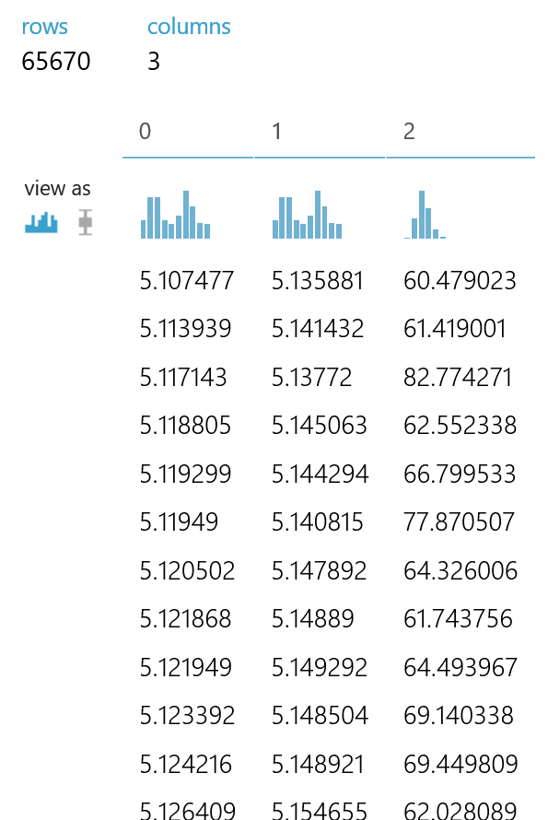
Feature engineering
Sometimes you have to massage the data before it becomes useful in answering your question.
Questions or comments?
brohrer@microsoft.com

Slide 38
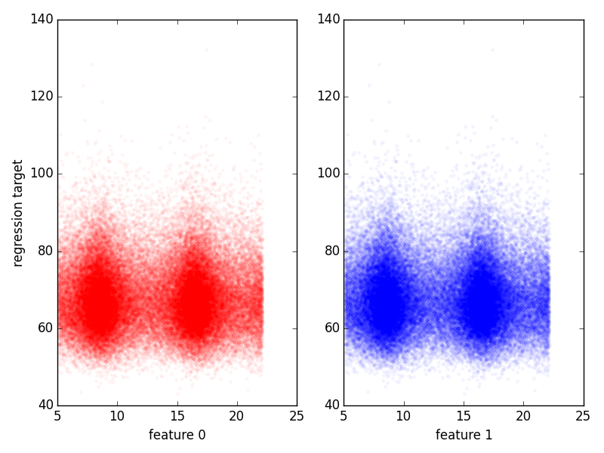

Slide 40
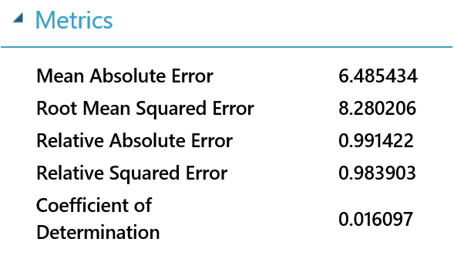

Slide 41
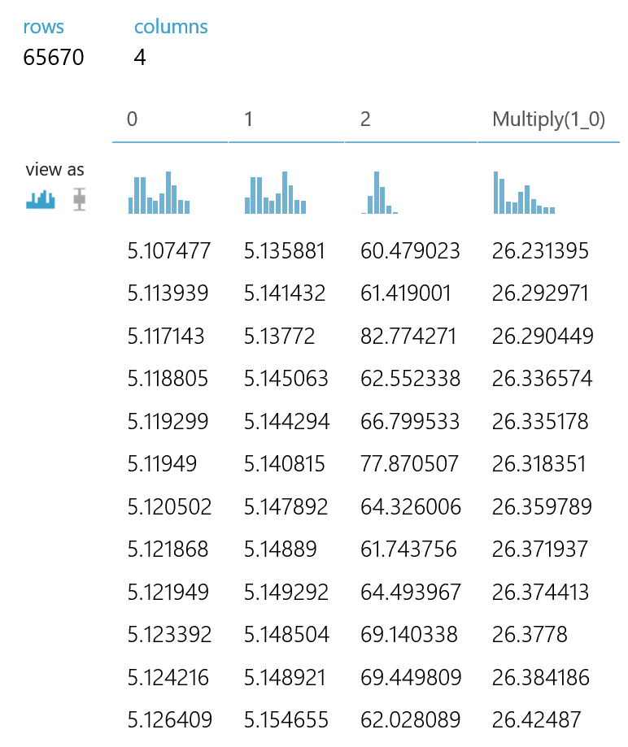
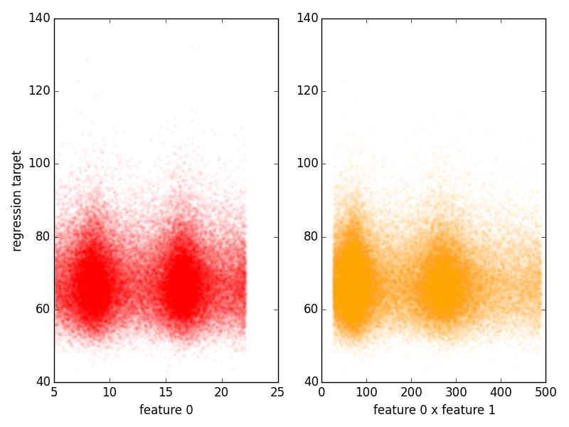

Slide 42
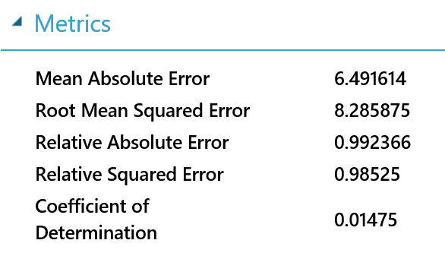

Slide 43
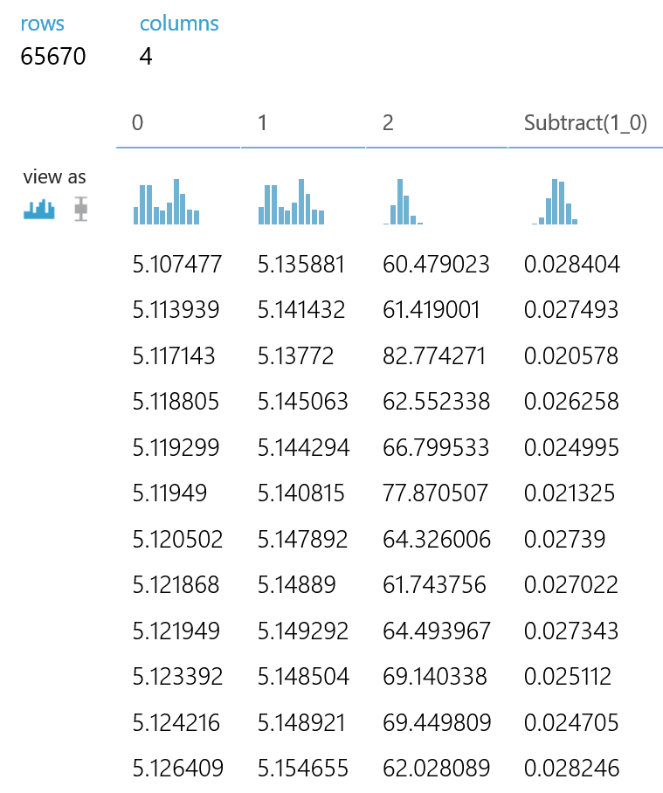
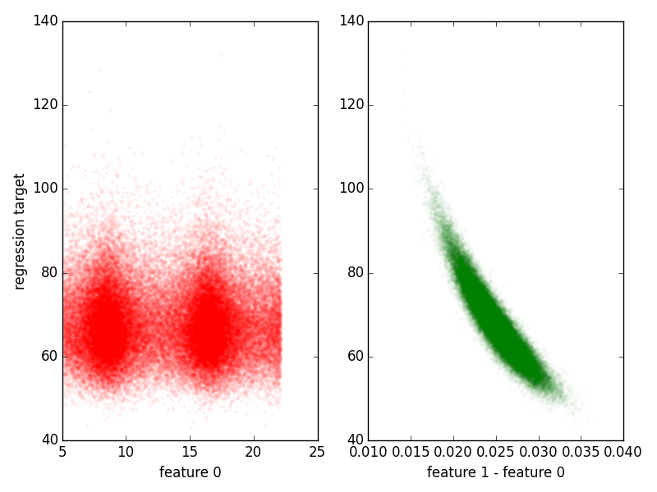

Slide 45
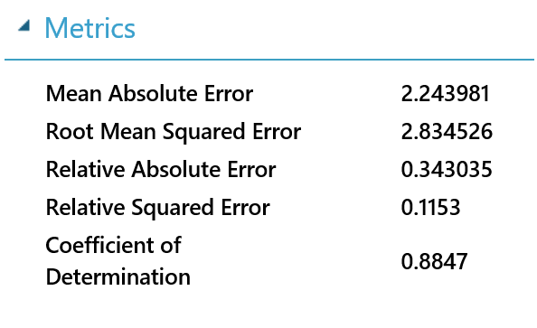

Slide 46
Other feature engineering tricks
Data-specific
Images (SIFT)
Text (TF-IDF)
Domain specific
Econometric, agricultural, sociological, …
Deep learning
Images, text, audio
Questions or comments?
brohrer@microsoft.com

Slide 47
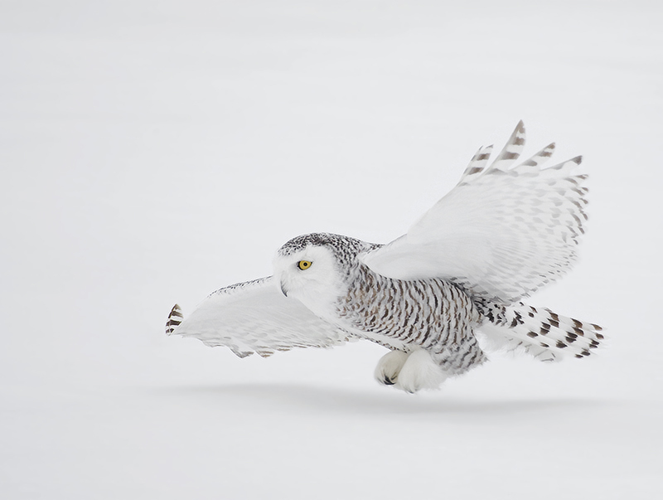
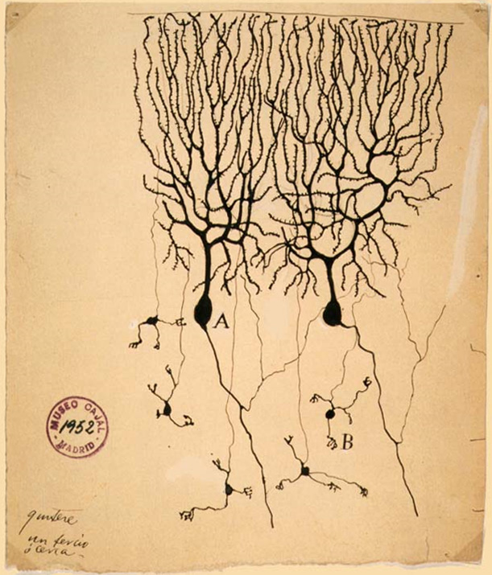
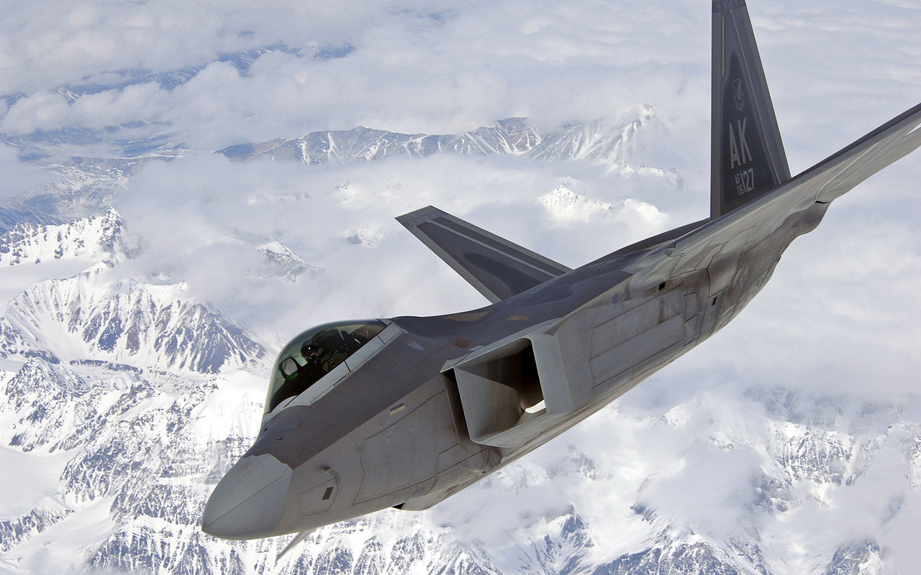
Deep Learning Demystified
Creative Commons 3
David Hemmings
public domain
Questions or comments?
brohrer@microsoft.com

Slide 49
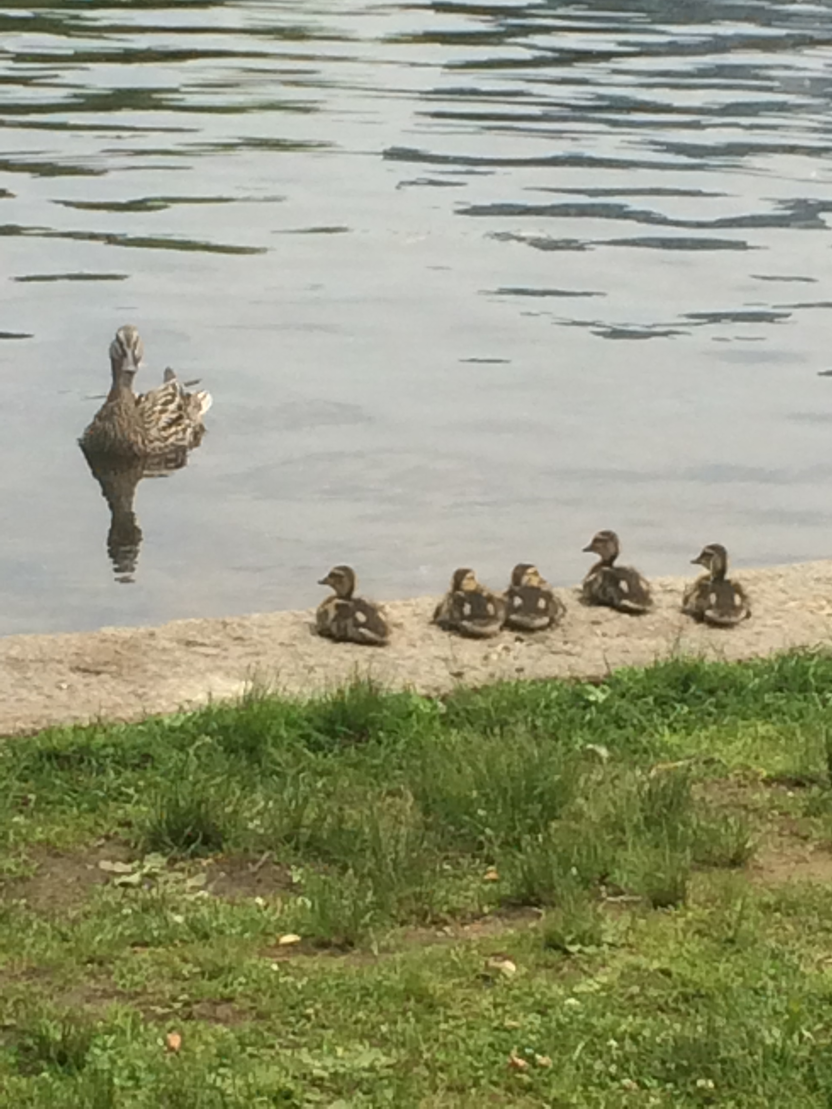
1. How much / how many?
2. Which category?
3. Which groups?
4. Is it weird?
5. Which action?
[algorithm]
Questions or comments?
brohrer@microsoft.com
Notes:
Good news: Most business and technical questions can be framed as one of these.
The answer is a name or a number.

Slide 50
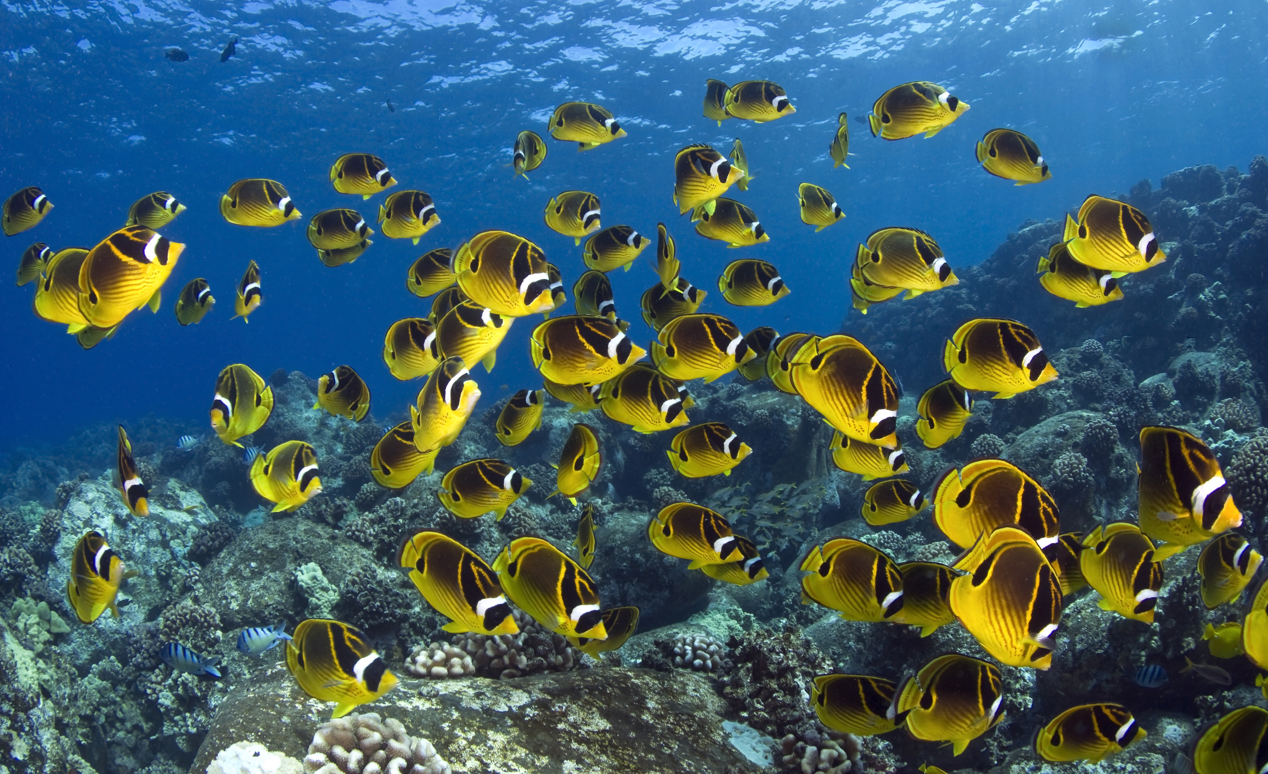
How much / how many?
What will the temperature be next Tuesday?
What will my fourth quarter sales in Portugal be?
How many new followers will I get next week?
Questions or comments?
brohrer@microsoft.com
Notes:
Examples positive and negative

Slide 51
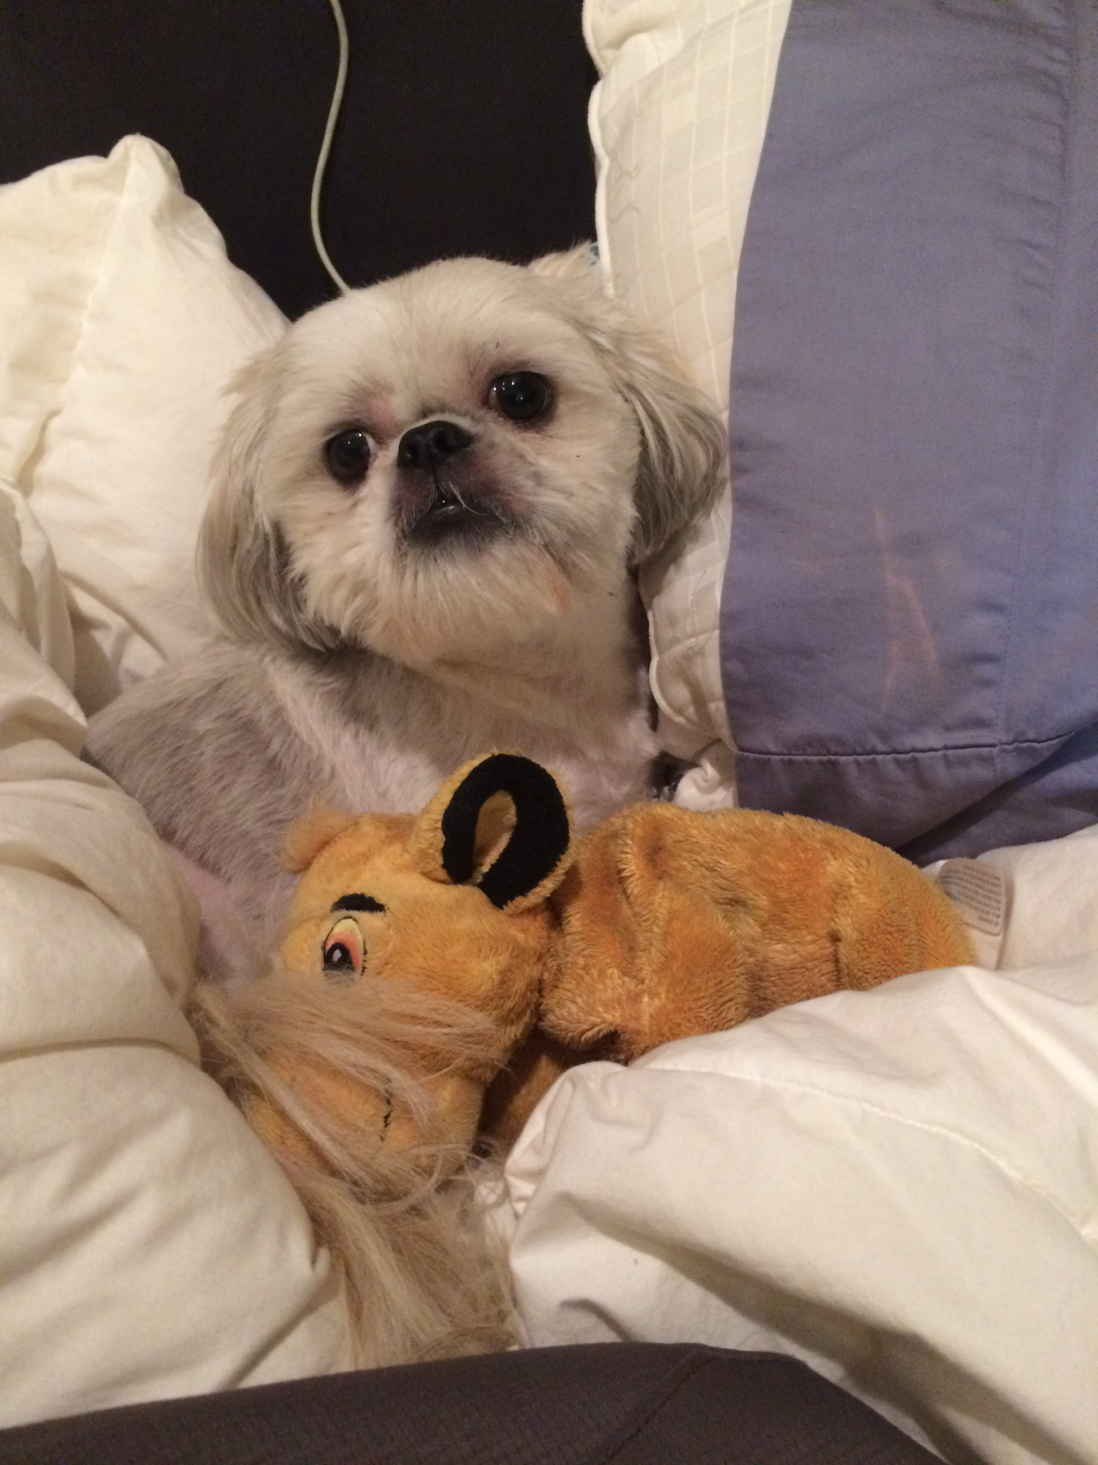
Which category?
Is this an image of a cat or a dog?
Which aircraft is causing this radar signature?
What is the topic of this news article?
[classification]
Questions or comments?
brohrer@microsoft.com
Notes:
Examples positive and negative

Slide 52
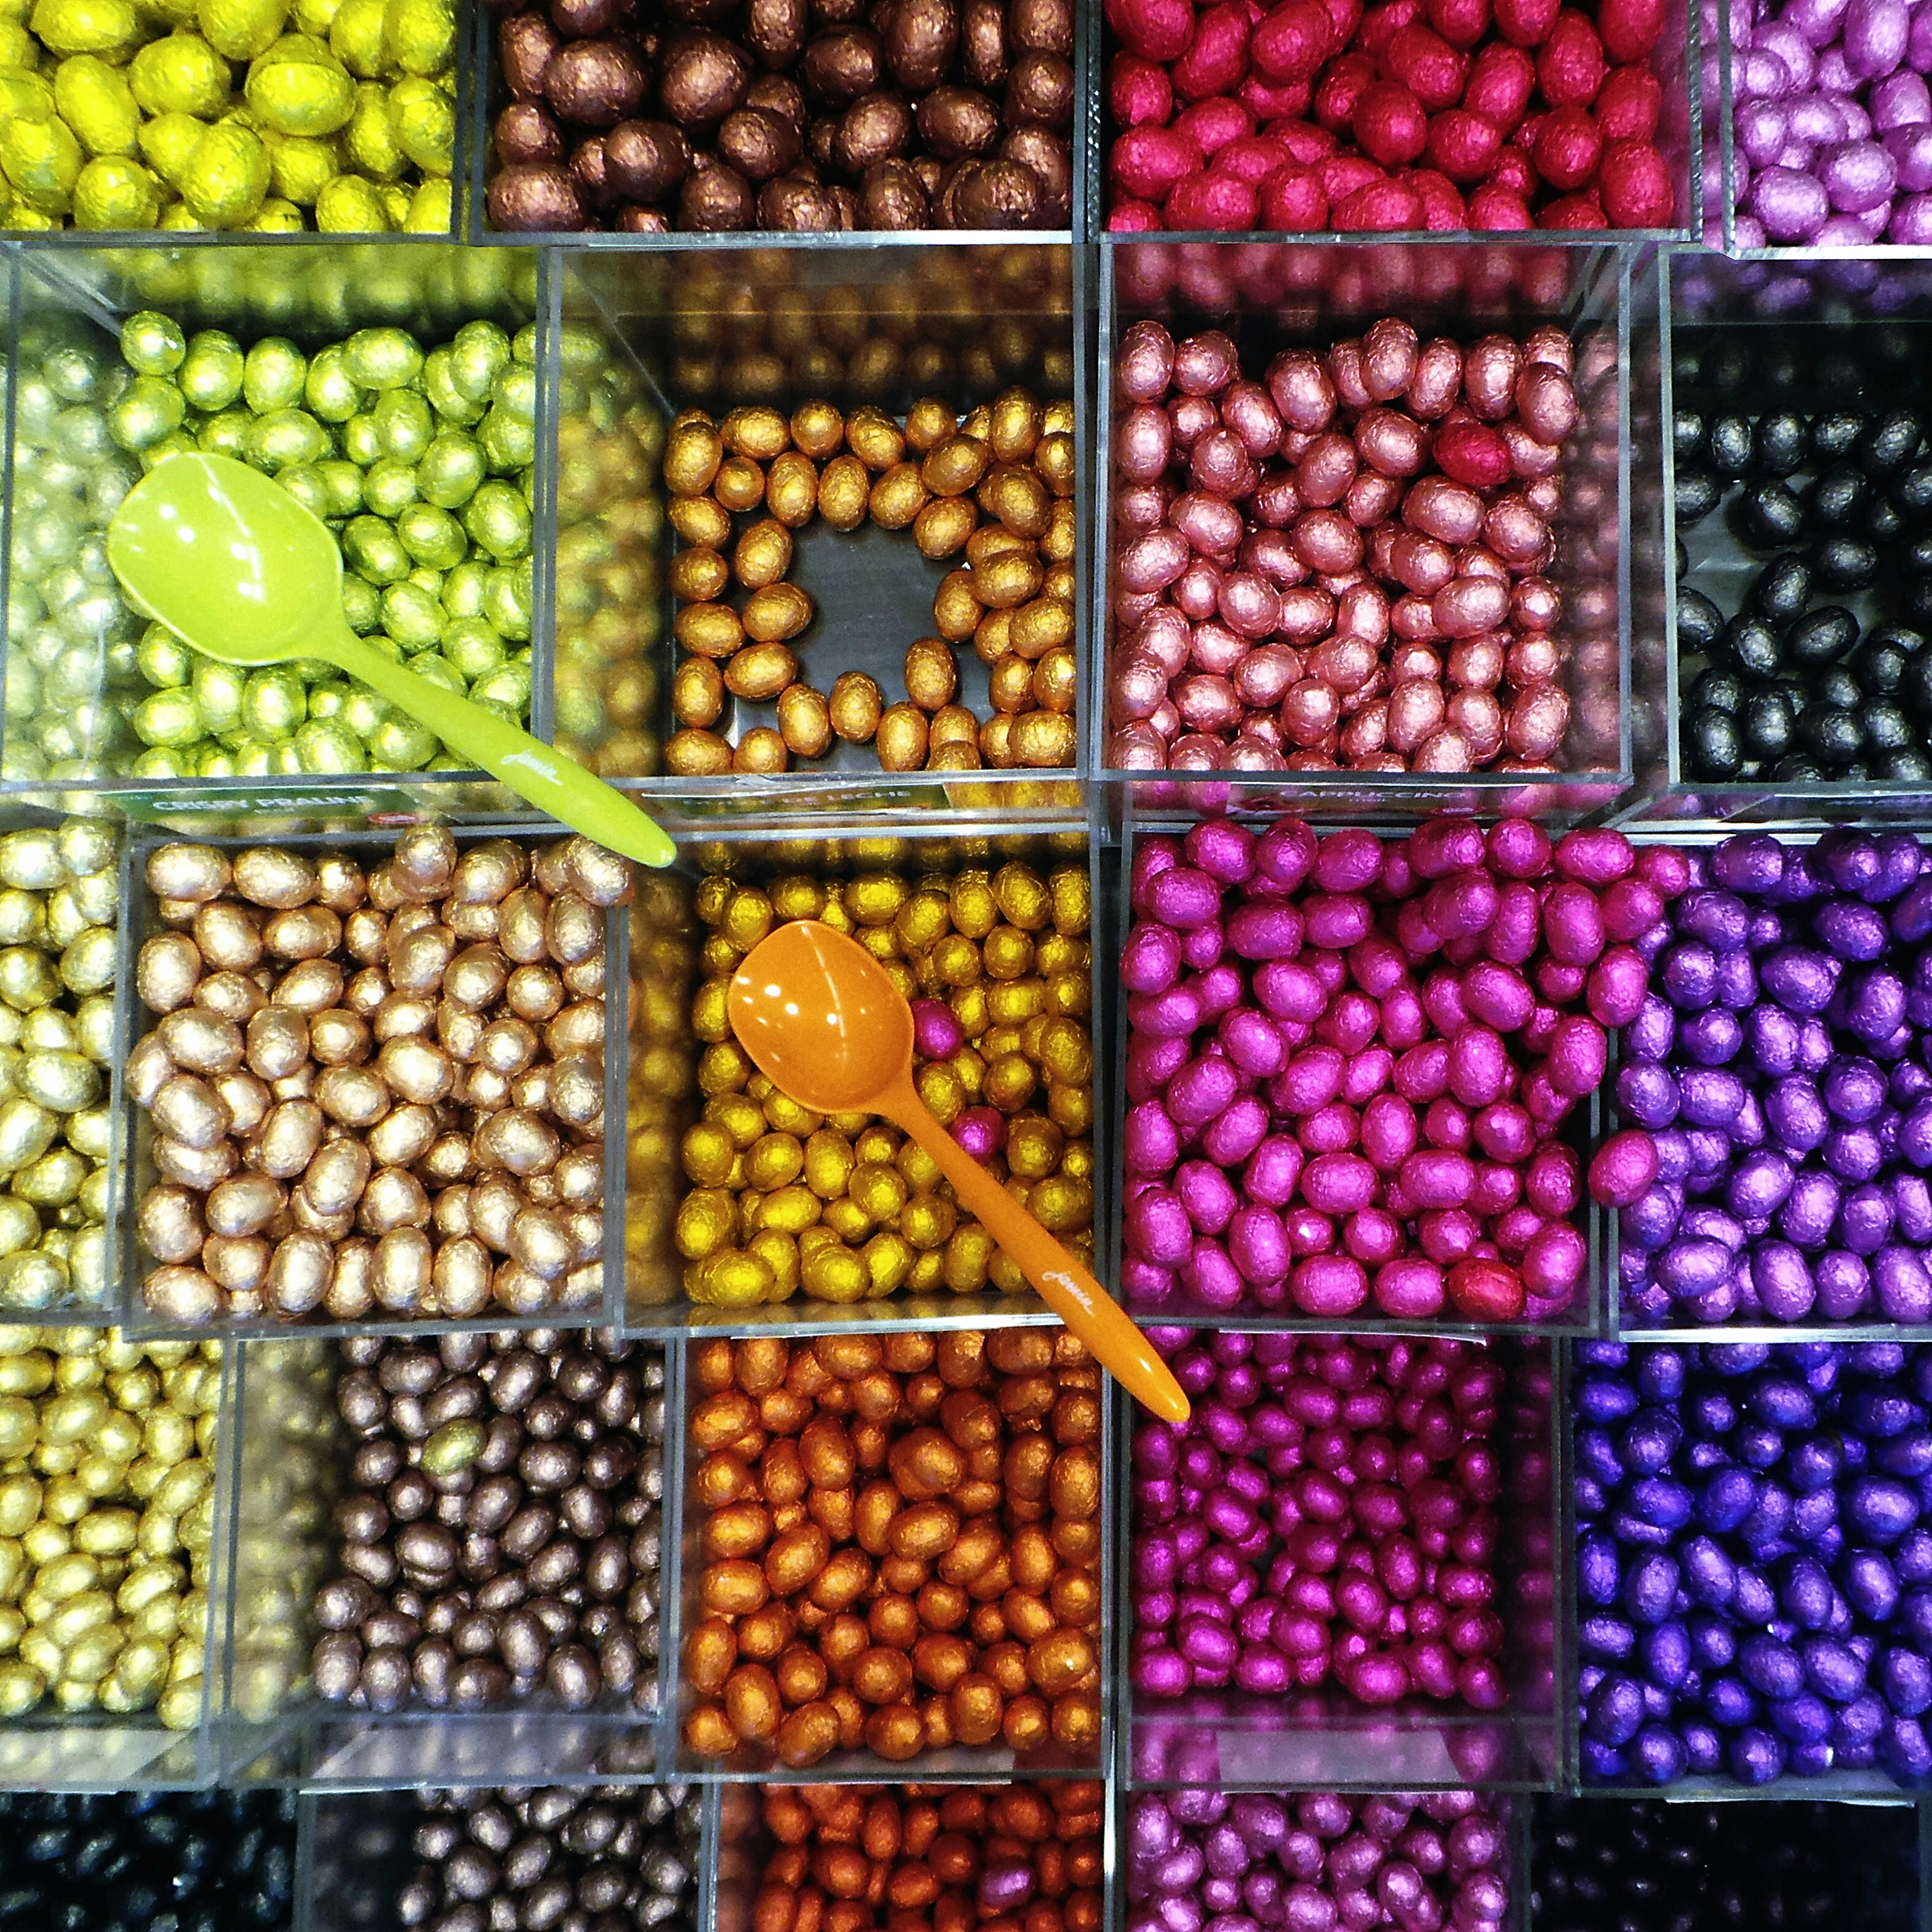
Which groups?
Which shoppers have similar tastes in produce?
Which viewers like the same kind of movies?
What is a natural way to break these documents into five topic groups?
Questions or comments?
brohrer@microsoft.com
Notes:
Examples positive and negative

Slide 53

Is this weird?
Is this pressure reading unusual?
Is this internet message typical?
Is this combination of purchases very different from what this customer has made in the past?
Questions or comments?
brohrer@microsoft.com
Notes:
Examples—positive and negative

Slide 54
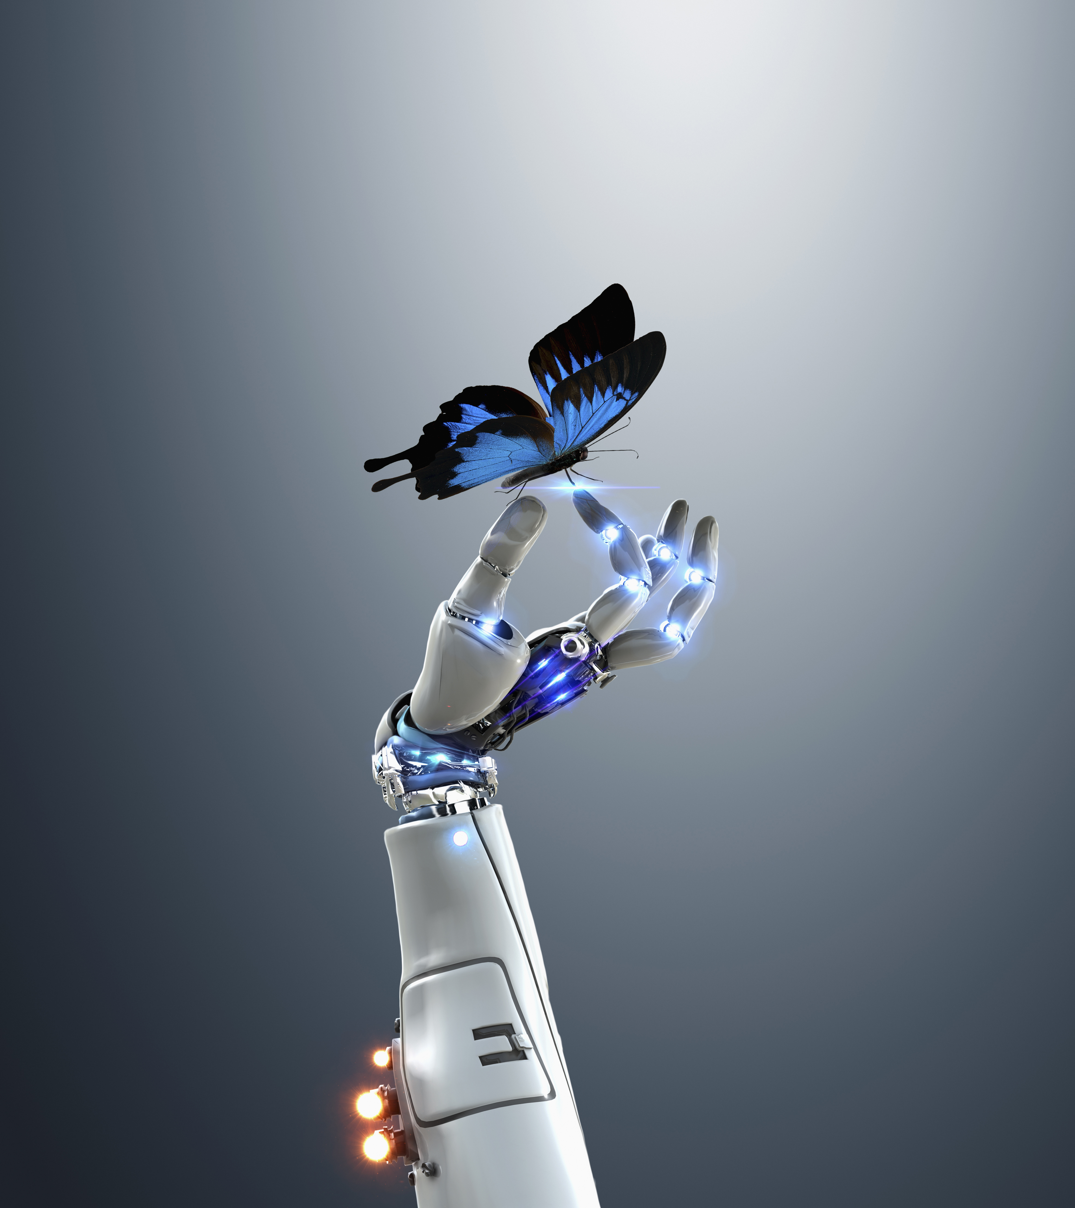
Which action?
Should I raise or lower the temperature?
Should I vacuum the living room again or stay plugged in to my charging station?
Should I brake or accelerate in response to that yellow light?
Questions or comments?
brohrer@microsoft.com
Notes:
Examples positive and negative

Slide 55
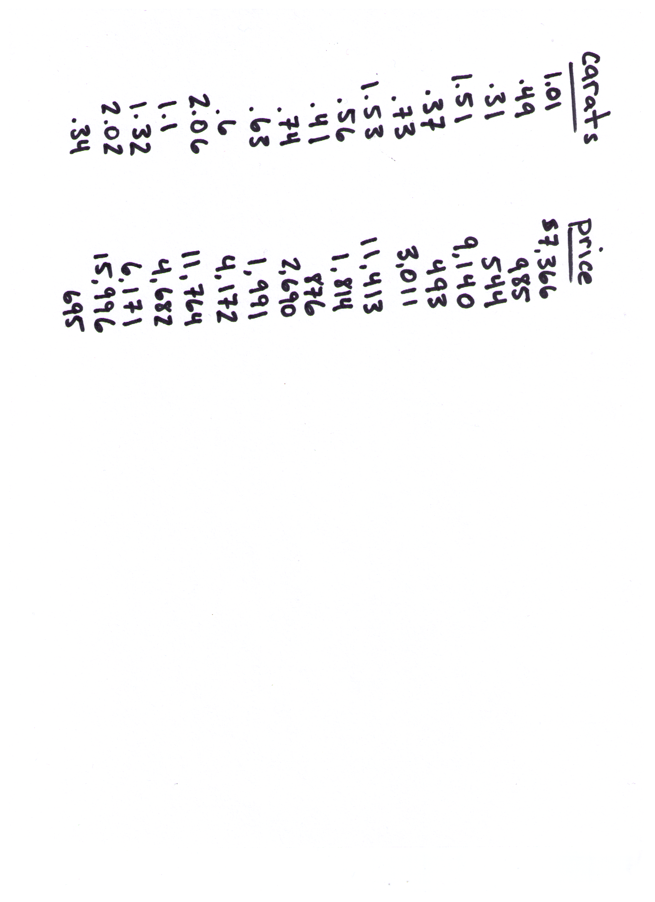

Diamonds
Questions or comments?
brohrer@microsoft.com
Notes:
Raw values

Slide 56
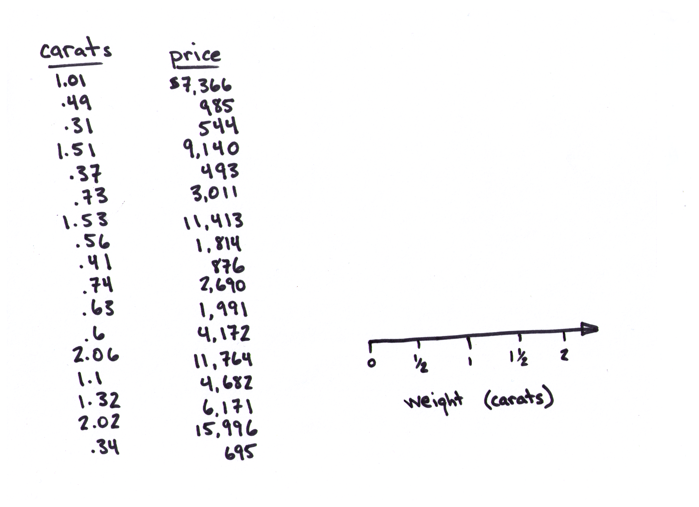
Diamonds
Questions or comments?
brohrer@microsoft.com
Notes:
Raw values

Slide 57
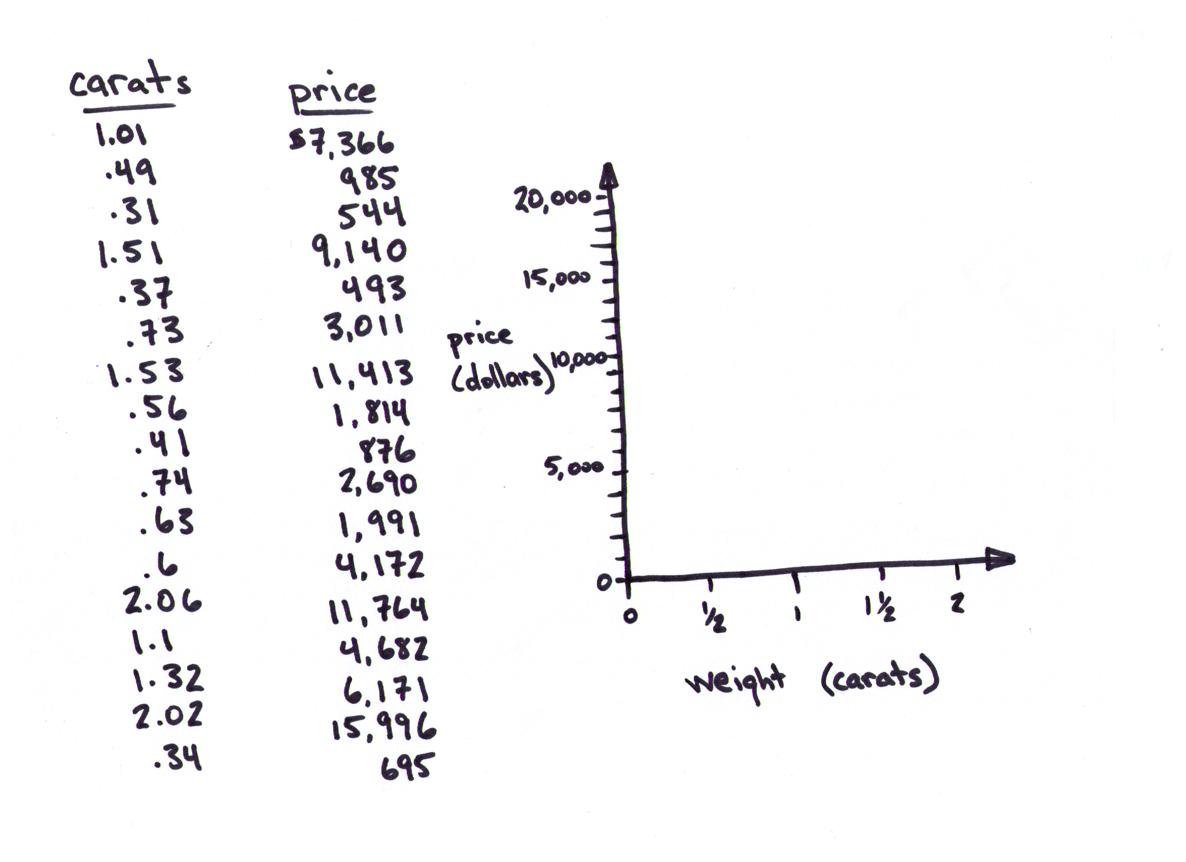
Diamonds
Questions or comments?
brohrer@microsoft.com
Notes:
Raw values

Slide 58
Diamonds
Questions or comments?
brohrer@microsoft.com
Notes:
Raw values

Slide 59
Diamonds
Questions or comments?
brohrer@microsoft.com
Notes:
Raw values

Slide 60
Diamonds
Questions or comments?
brohrer@microsoft.com
Notes:
Raw values

Slide 61
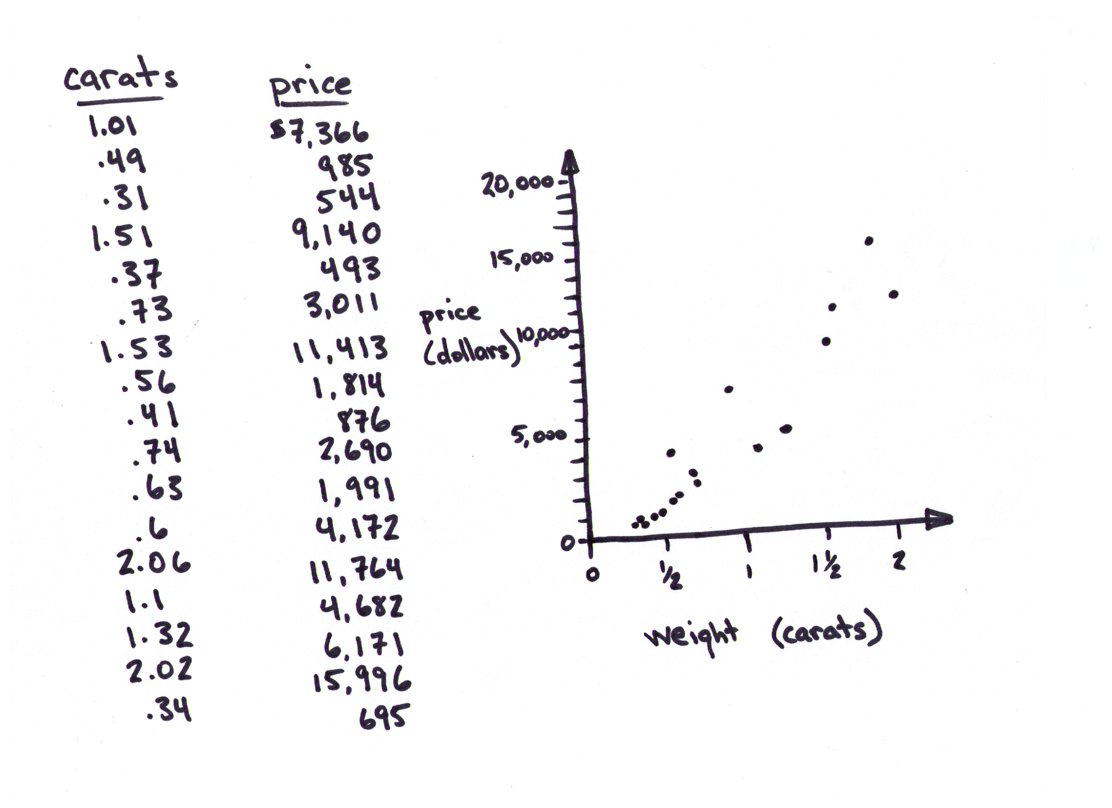
Diamonds
Questions or comments?
brohrer@microsoft.com
Notes:
Raw values

Slide 62
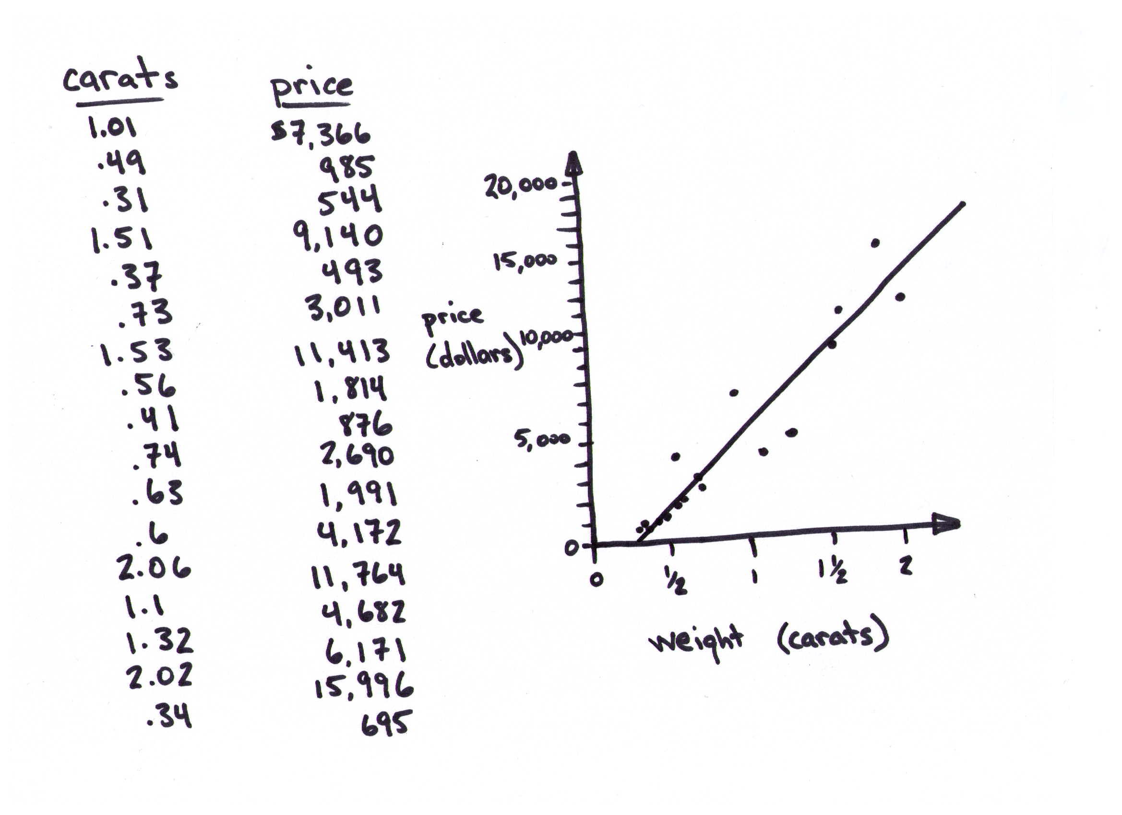
Diamonds
Questions or comments?
brohrer@microsoft.com
Notes:
Raw values

Slide 63
Diamonds
Questions or comments?
brohrer@microsoft.com
Notes:
Raw values

Slide 64
Diamonds
[prediction]
Questions or comments?
brohrer@microsoft.com
Notes:
Raw values

Slide 65
Diamonds
Questions or comments?
brohrer@microsoft.com
Notes:
Raw values

Slide 66
Diamonds
Questions or comments?
brohrer@microsoft.com
Notes:
Raw values

Slide 67

Not enough data
Questions or comments?
brohrer@microsoft.com
Notes:
Ingredient 4
Ice cream

Slide 68

Barely enough data
Questions or comments?
brohrer@microsoft.com

Slide 69
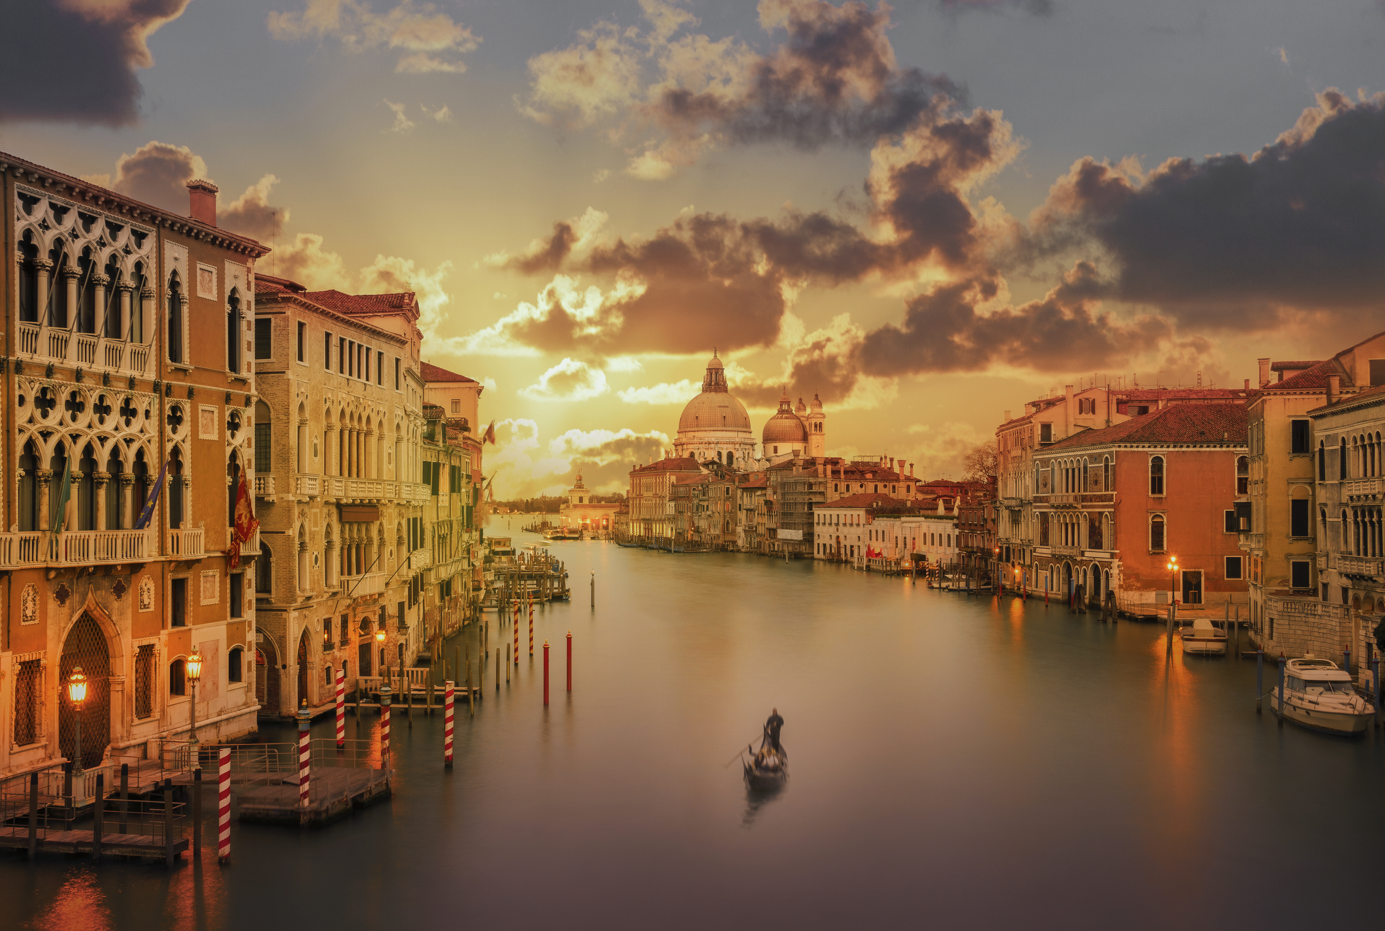
Enough data
Questions or comments?
brohrer@microsoft.com

Slide 71
Ways to use your answer
Make a web service (Azure Machine Learning)
Make a decision
Set a price
Publish your code on GitHub
Write a PDF showing your results
Build a dash board (Power BI)
Questions or comments?
brohrer@microsoft.com

Slide 72
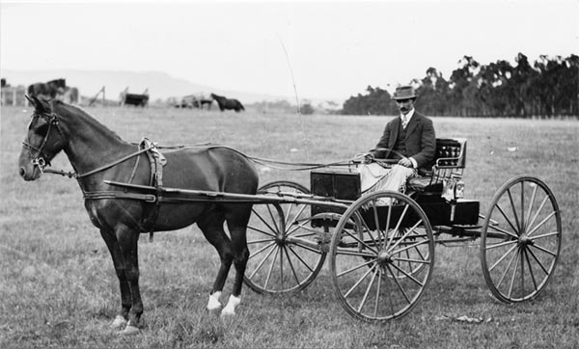
Gap 1
Nearly all machine learning algorithms assume that the world does not change.
Questions or comments?
brohrer@microsoft.com

Slide 73
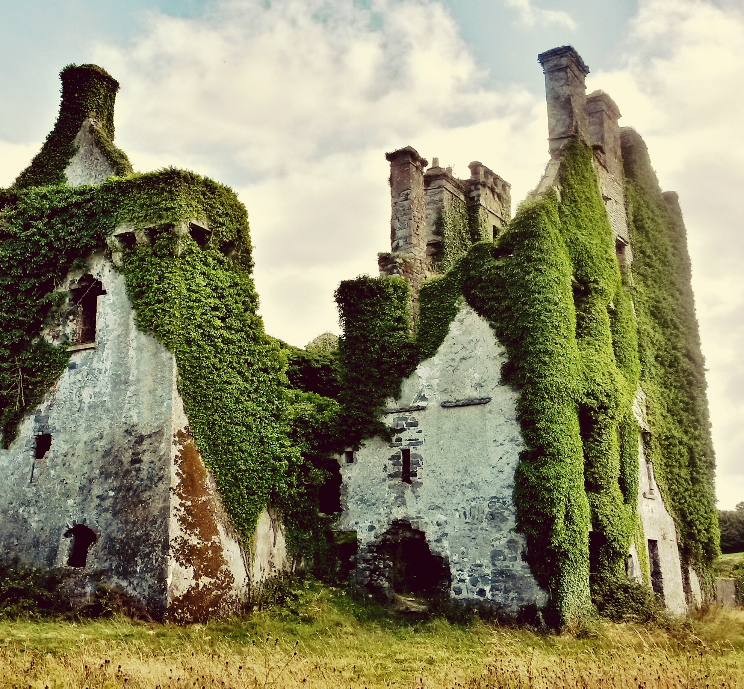
Gap 2
Most machine learning algorithms take a lot of examples to learn.
Questions or comments?
brohrer@microsoft.com

Slide 74
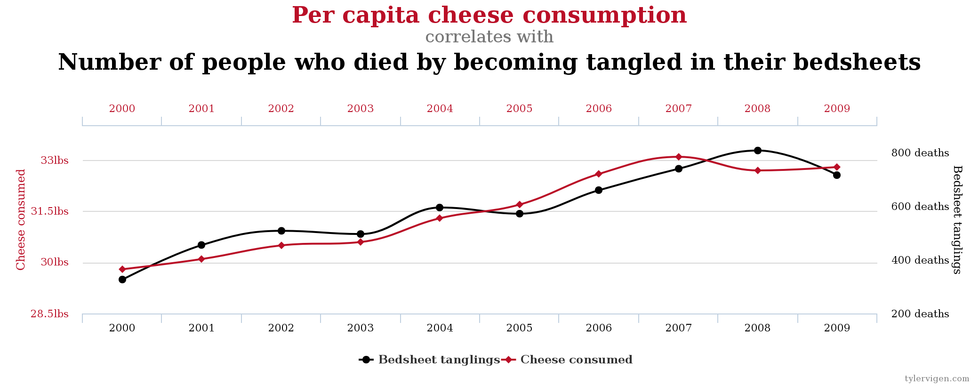
Gap 3
Machine learning can’t tell what caused what.
http://www.tylervigen.com/spurious-correlations

Slide 75
MLADS = Marvel : Les Agents du SHIELD

Slide 76
Coincidence?
MLADS = Marvel : Les Agents du SHIELD

Slide 77
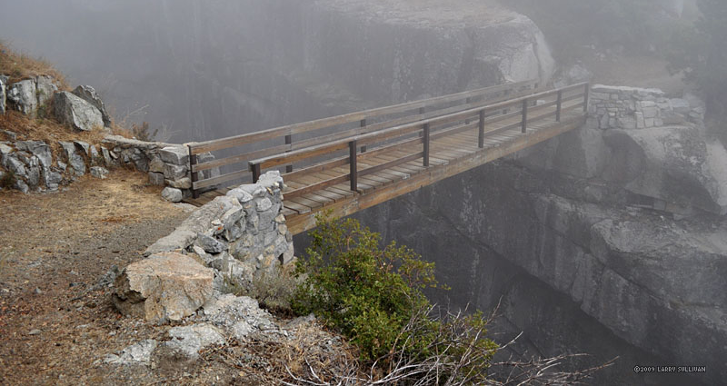
Human insight and judgment close the gap
We’re good at making reasonable guesses without enough information
Questions or comments?
brohrer@microsoft.com
http://150mph.planetrambler.com/090914-18_GreatWesternDivide/090914_0046.jpg

Slide 79
Resources
1. Get more data. | Microsoft Data Science Process
2. Ask a sharp question. | Asking a question
3. Put the data in a table.
4. Check for quality. | Methods for handling missing values
5. Transform features. | Feature engineering example
6. Answer the question. | Turn your data into a picture Questions machine learning can answer Algorithms for business use cases Machine learning algorithm cheat sheet Choosing a machine learning algorithm
7. Use the answer. | Cortana Intelligence Gallery
Presentations | Data Science for Absolutely Everyone (slides, pdf, video) Data Science 101 (slides, pdf, video) The Other Stuff (pdf, video) Demystifying neural networks (slides, pdf, video)
Questions or comments?
brohrer@microsoft.com

Slide 80
Thanks!
Questions? Want to chat about data?
LinkedIn Brandon Rohrer
@_brohrer_
brohrer.github.io
brohrer@microsoft.com
Special thanks to Diane Rohrer for image and layout design.

Slide 81
Rate this session!
Go to: http://aka.ms/mlads-surveys
to complete a 1-question poll about this session
You will also receive a post-event survey where you can provide detailed feedback.

